Slide 1
Tutorial Computational Intelligent
¹Department of Electronics Engineering,
National Kaohsiung University of Applied Sciences, Taiwan
These slides are modified from
A report of the Intelligent computation course (KUAS 2015-2016)
Professor: Chin-Shiuh Shieh
Student: Trong-The Nguyen

Slide 2
Outline
Introduction
Optimization methods
Differential evolution (DE)
Flower Pollination Algorithm (FPA)
Bat-Algorithm (BA)
Artificial Bee Colony Algorithm(ABC)
Demo
Conclusions

Slide 3
1. Introduction
Example 1 of optimization!
Find the shortest path from A to B
8
3
6
7
2
4
1
A
B
6
3
7
2
1
6
8

Slide 4
Find the shortest path from A to B
Answer = 7
8
3
6
7
2
4
1
A
6
B
3
7
2
1
6
8

Slide 5
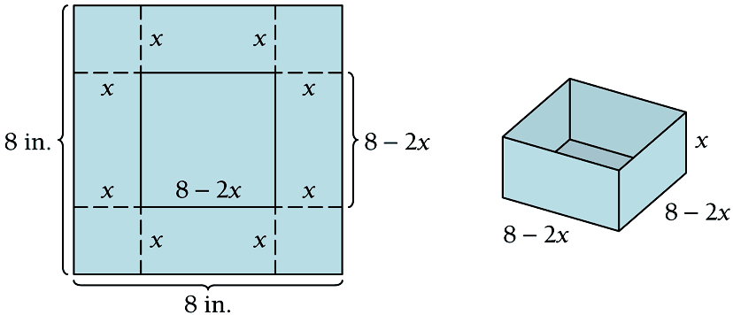
1. Introduction
Example 2 of optimization
What is the maximum volume?

Slide 6
Plot Max of V(x)
function y= volunm(x)
y = 4*x.^3 -32*x.^2 +64*x;
end

Slide 7
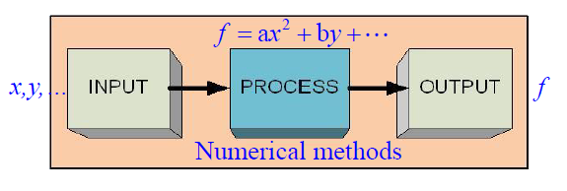
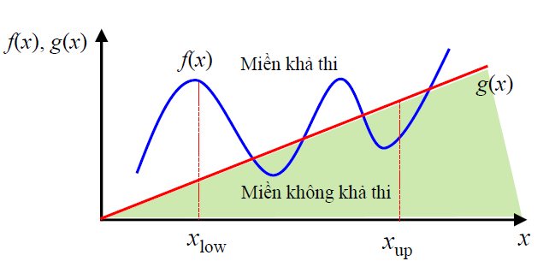
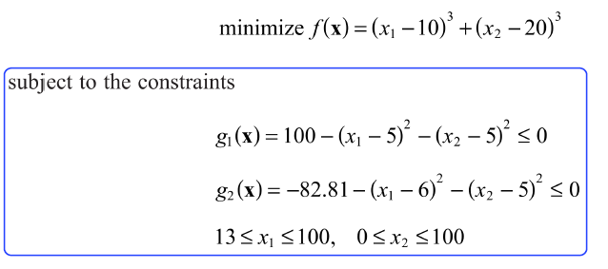
How to form an optimization problem

Slide 8
Example of optimization
Example 1 (continued):
2nd write an equation for the volume of the box.
Note that x must be between 0 and 4. So, we need to
maximize the volume equation on the interval (0, 4).

Slide 9
Maximum-Minimum
Example 1 (continued):
is the only critical value in (0, 4). So, we can use the second derivative.

Slide 10
Quick Check 1: sheep other paper sheet.
Next lets find the equation for volume:
Since, implies and implies
.
So, x must be between 0 and 4.25. So we must maximize the volume equation on the interval .

Slide 11
2. Methods for Optimization
Indirect | Direct
Conventional methods | Meta-heuristics
Gradient | Stochastic
Linear | Non-linear
Small scale | Large scale
Trust | Not guarantee of success
 | Nature-inspired

Slide 12
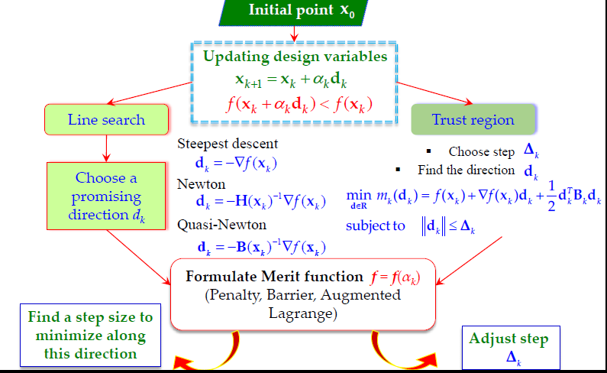
2.1. InDirect methods for Optimization
Indirect method

Slide 13
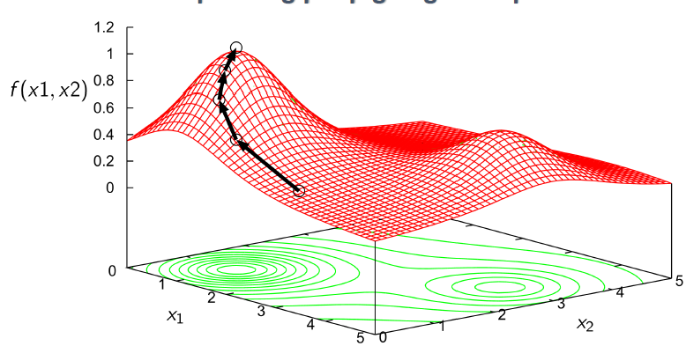
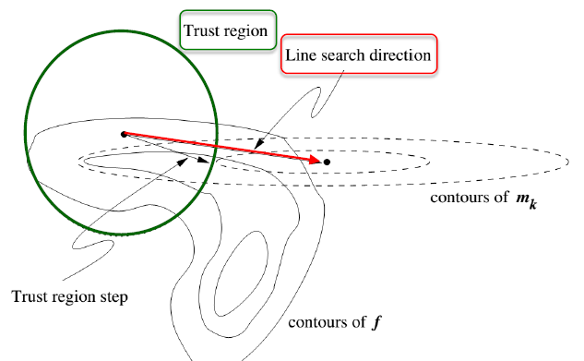
Indirect methods

Slide 14
Example 3. Graphical Representation of Linear Prgrm solution
X₂
X1≥0
Z=3x1+2X2
X1≤40
100
Objective function value
Z= 3*20+2*60=180
(0,80)
(20,60)
(40,20)
X1+X2≤80
Feasible
region
2X1+X2≤100
X2≥0
X₁
(0,0)
(40,0)
(50,0)
(80,0)

Slide 15
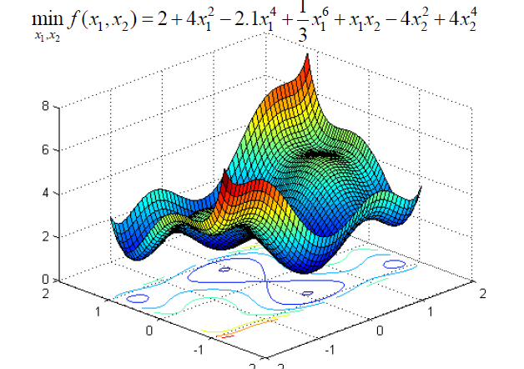
2. Direct methods for Optimization (cont.) Meta-hueristic

Slide 16
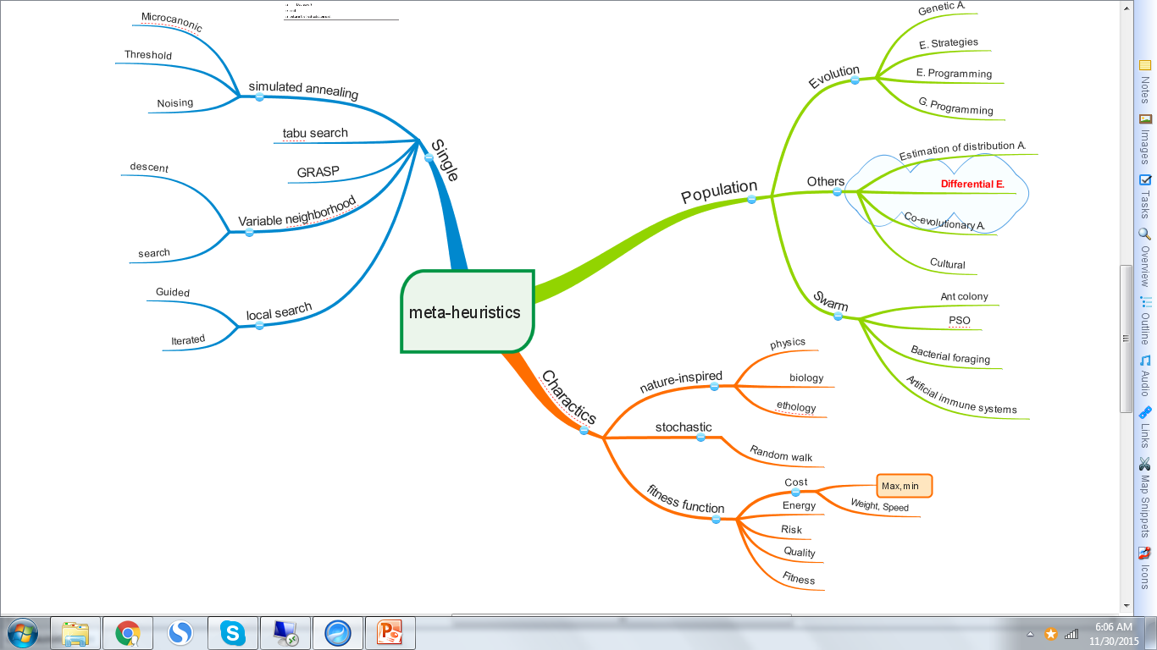
Meta-heuristics

Slide 17
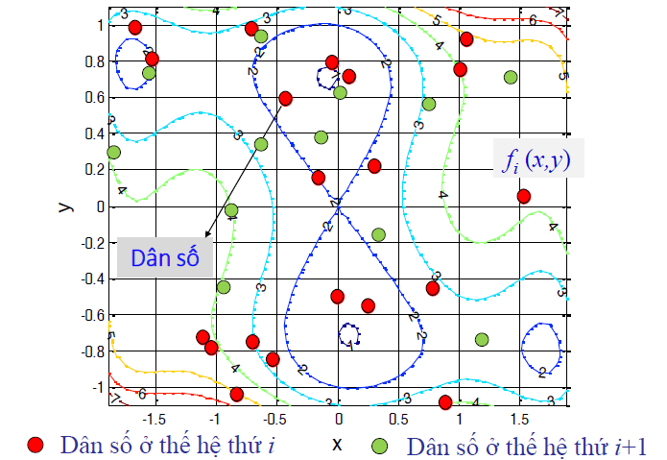
Direct methods

Slide 18
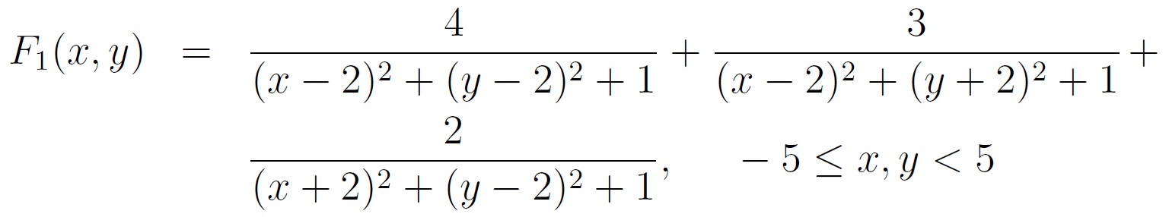
2.2. Object function
Object function can be written as
function y = fitness(x)
% Fitness function.
y = 4/((x(1)-2).^2 +(x(2)-2).^2+1)+3/((x(1)-2).^2 +(x(2)+2).^2+1)+2/((x(1)+2).^2 +(x(2)-2).^2+1);
end

Slide 19
Plot a fitness function (cont.)
x=-5:1:5; y=x
L=length(x);
f=[];
for i=1:L
for j=1:L
f(i,j)=fitness([x(i),y(j)]);
end
end
surfc(x,y,f,'LineStyle','none');

Slide 20
Plot a fitness function (cont.)
x=-5:1:5; y=x
L=length(x);
f=[];
for i=1:L
for j=1:L
f(i,j)=sphere([x(i),y(j)]);
end
end
surfc(x,y,f,'LineStyle','none');
% function f = sphere(x)
% f = sum(x.^2);
% end

Slide 21
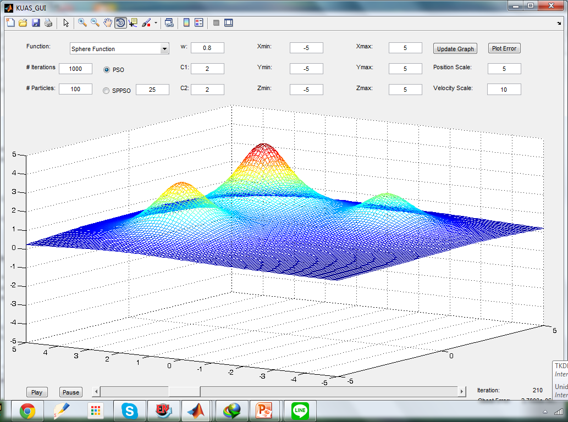
Metaheuristic Algorithms (Direct methods)
Differential evolution (DE)
Flower Pollination Algorithm (FPA)
Bat-Inspired Algorithm (BA)
Artificial Bee Colony Algorithm (ABC)

Slide 22
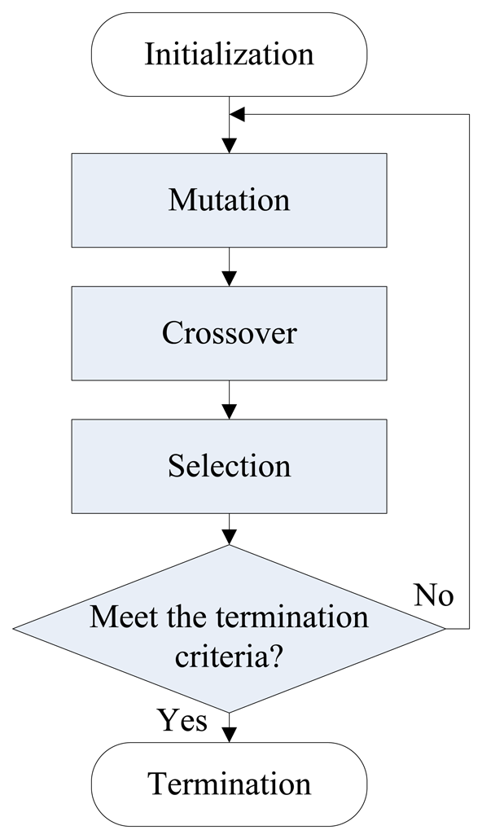
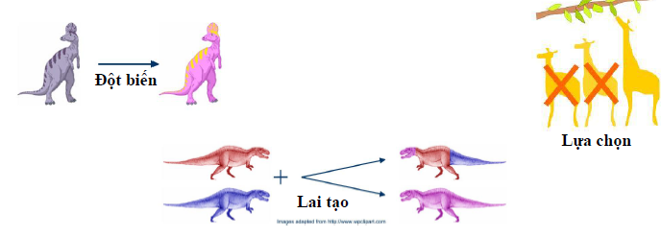
3. Differential evolution (DE)

Slide 23
3.1 A brief of DE
Differential Evolution
(Storn and Price in 1995)
a stochastic population based
evolutionary algorithm
fairly fast and
reasonably robust
A population
within an n-dimensional search space,
is randomly initialized,
then evolves over time
to explore the search space and
to locate the minima of the objective function

Slide 24
3.2 Compared to most other EAs
Differential Evolution (DE)
Considered as one of the most powerful evolutionary algorithms for real number function optimization nowadays
"Differential Evolution -- a simple and efficient adaptive scheme for global optimization over continuous spaces, 1995”

Slide 25
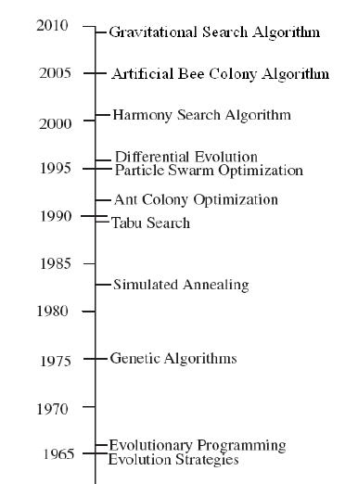
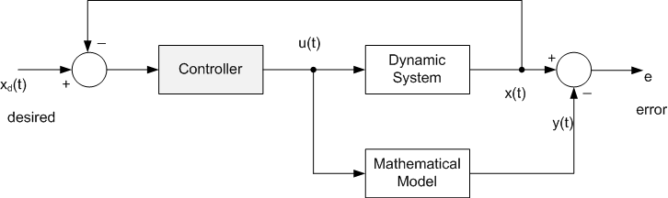
3.2 . Meta-heuristics algorithms
Adaptive Control Schema
From: the state of the Art meta-heu- Sci. Eng. Technol., 4(9): pp.1181-1197, 2012

Slide 26


3.2 Compared (cont.)
Note that although PSO
is also very easy to code,
the performance of DE and its variants
is largely better than the PSO variants over a wide variety of problems as has been indicated by studies as followse:

Slide 27
3.3 Taxonomy
Differential Evolution is
a Stochastic Direct Search and Global Optimization algorithm, and is
an instance of an Evolutionary Algorithm from the field of Evolutionary Computation.
It is related to sibling Evolutionary Algorithms
the Genetic Algorithm,
Evolutionary Programming, and
Evolution Strategies, and
has some similarities with Particle Swarm Optimization

Slide 28
3.4 Strategy of DE
Involves maintaining a population of candidate solutions subjected to iterations of
recombination,
evaluation, and
selection.
The recombination approach
involves the creation of new candidate solution components based on
the weighted difference between two randomly selected population members added to a third population member.
This perturbs population members relative to the spread of the broader population.
In conjunction with selection,
the perturbation effect self-organizes the sampling of the problem space, bounding it to known areas of interest.

Slide 29
3.5 Background
DE’s Main Idea: (DE/rand/1)
Generate trial vectors (v) using the following formula:
It elegantly replaces the two operations:
Crossover
Mutation
Less parameters to be tuned
Self-organizing ability

Slide 30
Background
http://ocw.mit.edu/NR/rdonlyres/Sloan-School-of-Management/15-099Fall2003/A40397B9-E8FB-4B45-A41B-D1F69218901F/0/ses2_storn_price.pdf

Slide 31
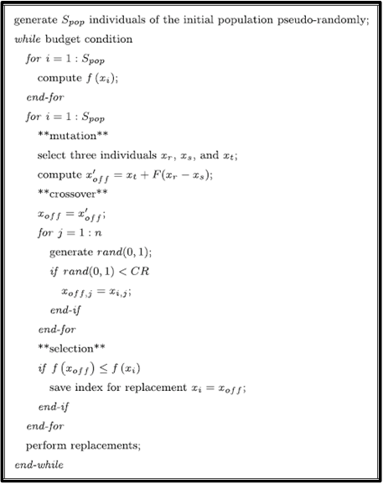
3. 5 Pseudo code DE/rand/1/bin
Other mutation rules:
DE/best/1
DE/cur-to-best/1
DE/best/2
DE/rand/2
DE/rand-to-best/2
Only three parameters
F (scale factor) CR (crossover ratio)
S_{pop} (population size)
Notes:
Pseudo code

Slide 32
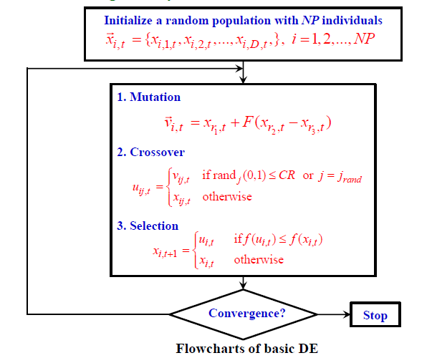
Flowchart DE

Slide 33
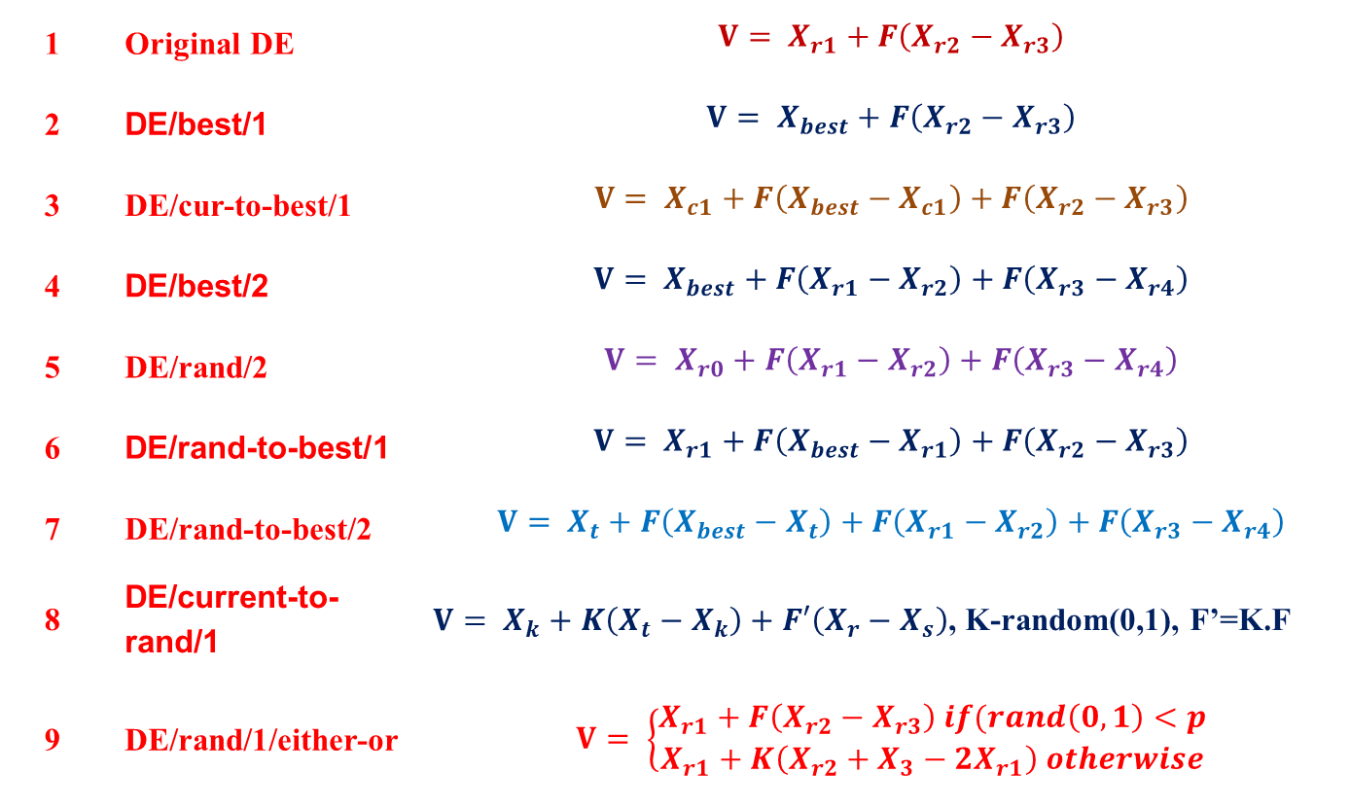
3.6. DE Variants
1 | Original DE | $$V= X_{r1}+F\left(X_{r2}−X_{r3}\right)$$
2 | DE/best/1 | $$V= X_{best}+F\left(X_{r2}−X_{r3}\right)$$
3 | DE/cur-to-best/1 | $$V= X_{c1}+F\left(X_{best}−X_{c1}\right)+F\left(X_{r2}−X_{r3}\right)$$
4 | DE/best/2 | $$V= X_{best}+F\left(X_{r1}−X_{r2}\right)+F\left(X_{r3}−X_{r4}\right)$$
5 | DE/rand/2 | $$V= X_{r0}+F\left(X_{r1}−X_{r2}\right)+F\left(X_{r3}−X_{r4}\right)$$
6 | DE/rand-to-best/1 | $$V= X_{r1}+F\left(X_{best}−X_{r1}\right)+F\left(X_{r2}−X_{r3}\right)$$
7 | DE/rand-to-best/2 | $$V= X_{t}+F\left(X_{best}−X_{t}\right)+F\left(X_{r1}−X_{r2}\right)+F\left(X_{r3}−X_{r4}\right)$$
8 | DE/current-to-rand/1 | $V= X_{k}+K\left(X_{t}−X_{k}\right)+F′\left(X_{r}−X_{s}\right)$, K-random(0,1), F’=K.F
9 | DE/rand/1/either-or | $$V= \left\{\begin{aligned}X_{r1}+F\left(X_{r2}−X_{r3}\right) if(rand\left(0,1\right)<p \\ X_{r1}+K\left(X_{r2}+X_{3}−{2X}_{r1}\right) otherwise\end{aligned}\right.$$

Slide 34
3.7. Example (DE)

Slide 35
Flowchart DE

Slide 36
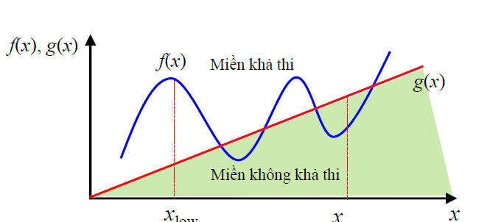
Initialization
for j = 1:Popsize
Pop(j,:) = Lb + (Ub-Lb).*rand(1,dim);
% Fx(j) = feval(fitness,Pop(j,:));
end

Slide 37
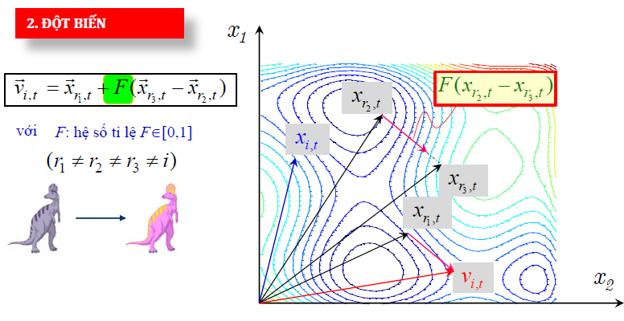
Generate Xr1, Xr2 and Xr3
function[r] = generate(NP, j)
r1 = j; % randomly select r1
whiler1==j;
r1 = randi(NP,1,1); end
r2 = j; % randomly select r2
whiler2==r1 || r2==j
r2 = randi(NP,1,1); end
r3 = j; % randomly select r3
whiler3 == j || r3 == r1 || r3 == r2
r3 = randi(NP,1,1); end
r = [r1,r2,r3];

Slide 38
function offpop = MutAndCrossover( x, NP, lu, Dim )
%MANDX Summary of this function goes here
% Detailed explanation goes here
F =1.8;
CR = 0.5;
offpop = zeros(NP,Dim);
for i=1:NP
[r] = Generate(NP,i);
v = x(r(1), :)+F.*(x(r(2),:)-x(r(3),:));
% Check for boundary of v
v = Simplebound(v,lu)
%v = Checkboundary(v,lu);
%3. Crossoever
jRand = floor(rand*Dim)+1;
t = rand(1,Dim)<CR;
t(1, jRand)=1;
t_=1-t;
u = t.*v +t_.*x(i,:);
offpop(i,:)=u;
end
end

Slide 39
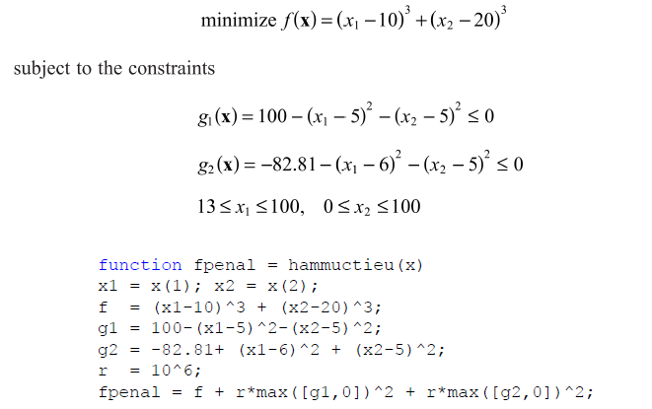
Example 1
Ojf = @fun1;
lb= [13 0];
ub = [100 100];
NP = 20;
Dim = 2;
tol = 1e-6;
mxgen = 200;
[xval, fval, iter, val] = DE(Ojf, NP, Dim, lb,ub,tol, mxgen);

Slide 40
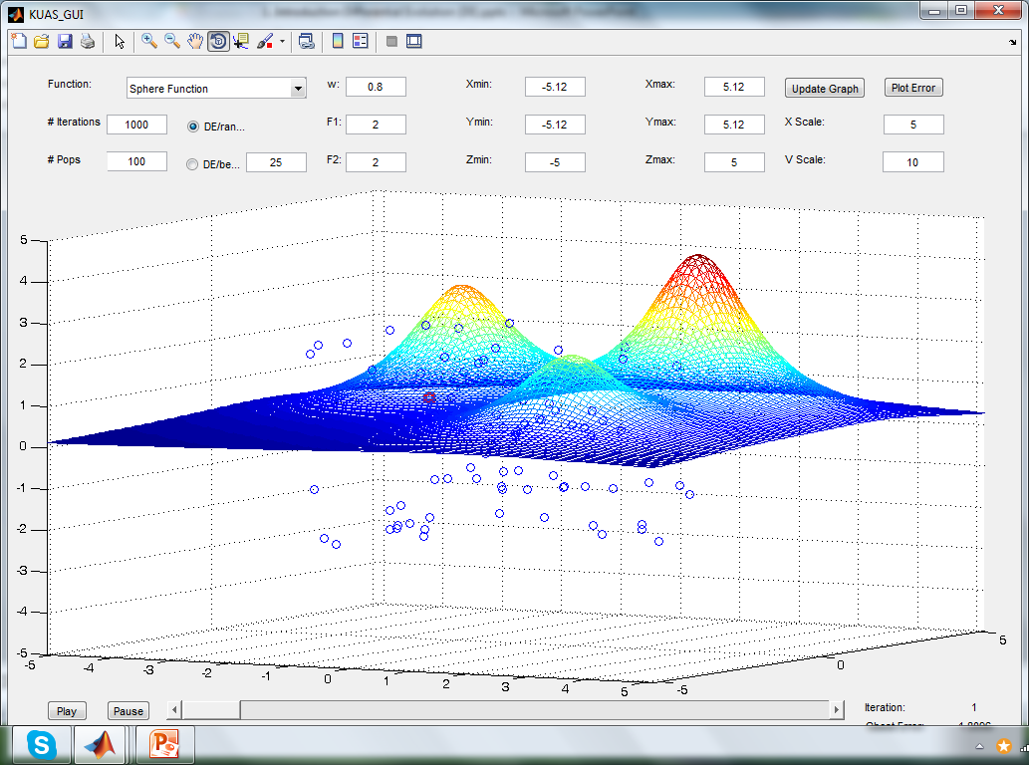
Demo for Sphere function

Slide 41
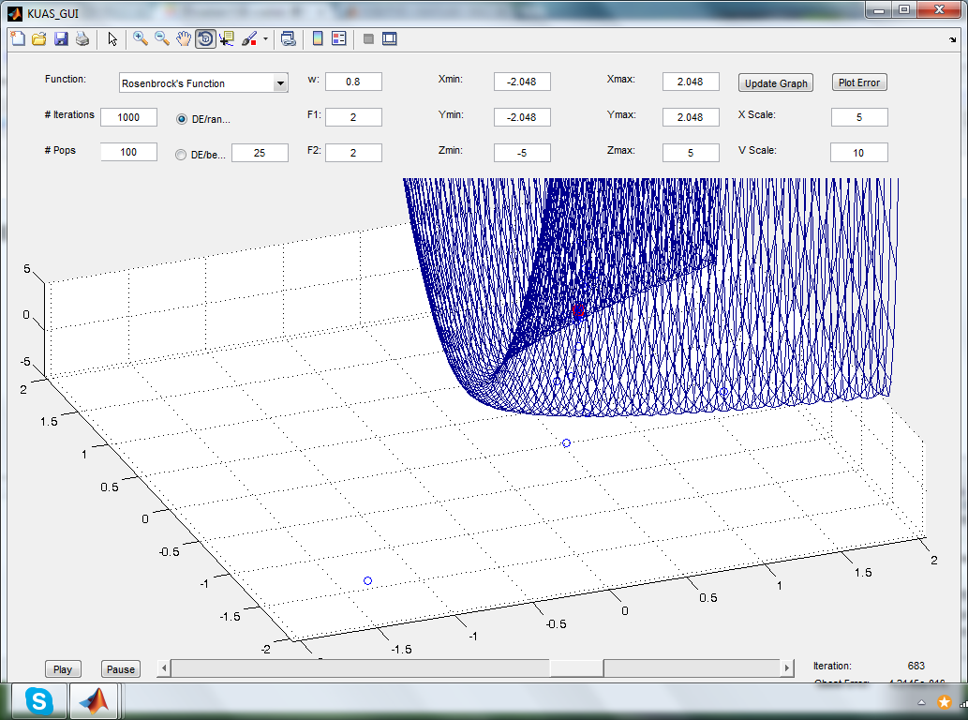
Demo for Rosenbrock function

Slide 42
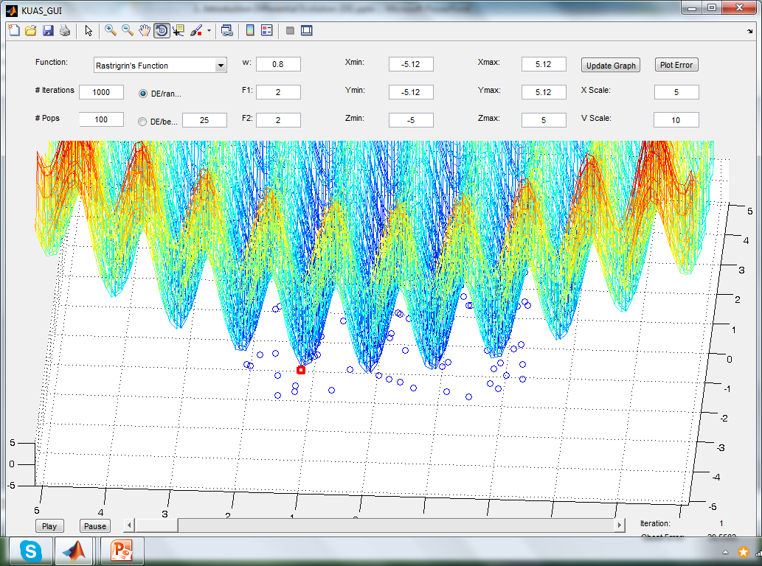
Demo for Rastrigrin function

Slide 43
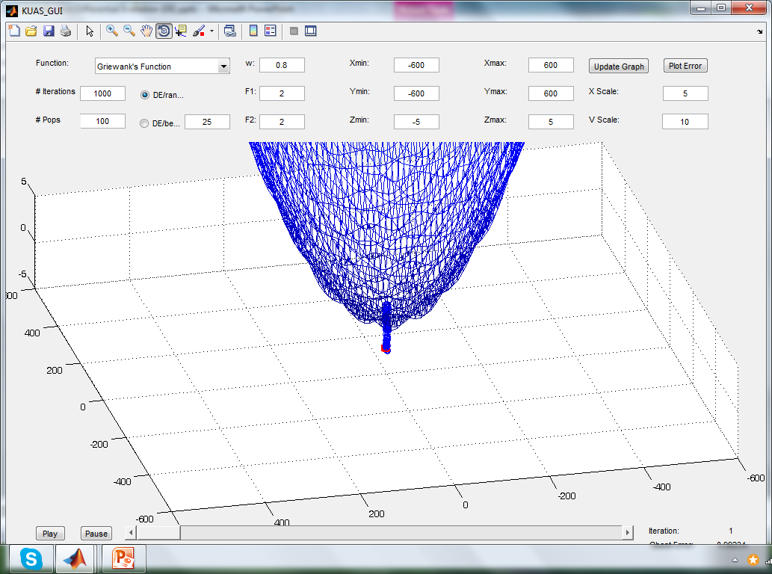
Demo for Griewank function

Slide 44
Conclusion
DE
a simple and efficient scheme for global optimization
fast optimization method for any kind of objective function
The control variables
initialization,
mutation,
diversity enhancement, and
selection

Slide 45
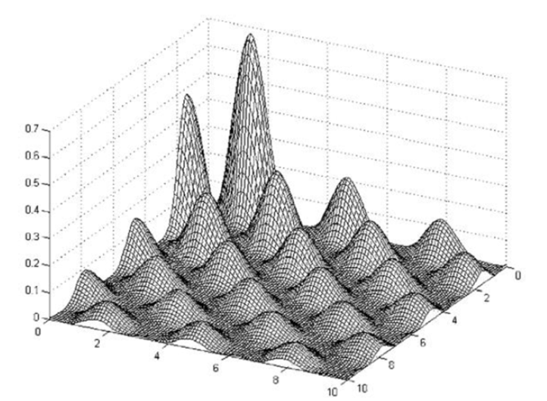
Conclusion
DE exhibits
remarkable performance in optimizing a wide variety of
multi-dimensional,
multiobjective and
multimodal optimization problems.

Slide 46

Thanks for your attention

Slide 47
The process of FPA
Pseudo code of the Flower pollination algorithm

Slide 48
4. Metaheuristic Bat-Inspired Algorithm
In 2010, Xin-SheYang proposed BA
based on swarm intelligence and
the inspiration from observing the bats
Three major characteristics of the micro-bat
echolocation behavior
the frequency with a variable wavelength λ
the loudness A₀ to search for prey.

Slide 49
4.1.The characteristics of micro-bat
Bats fly randomly with
velocity v_{i} at position x_{i} .
They can
adjust the wavelength (or frequency) of their emitted pulses and
adjust the rate of pulse emission r ∈ [0, 1], depending on the proximity of their target;
Ways to adjust the loudness
For simplicity, the loudness is assumed to be varied from
a positive large A₀ to a minimum constant value,
which is denoted by A_{min}

Slide 50
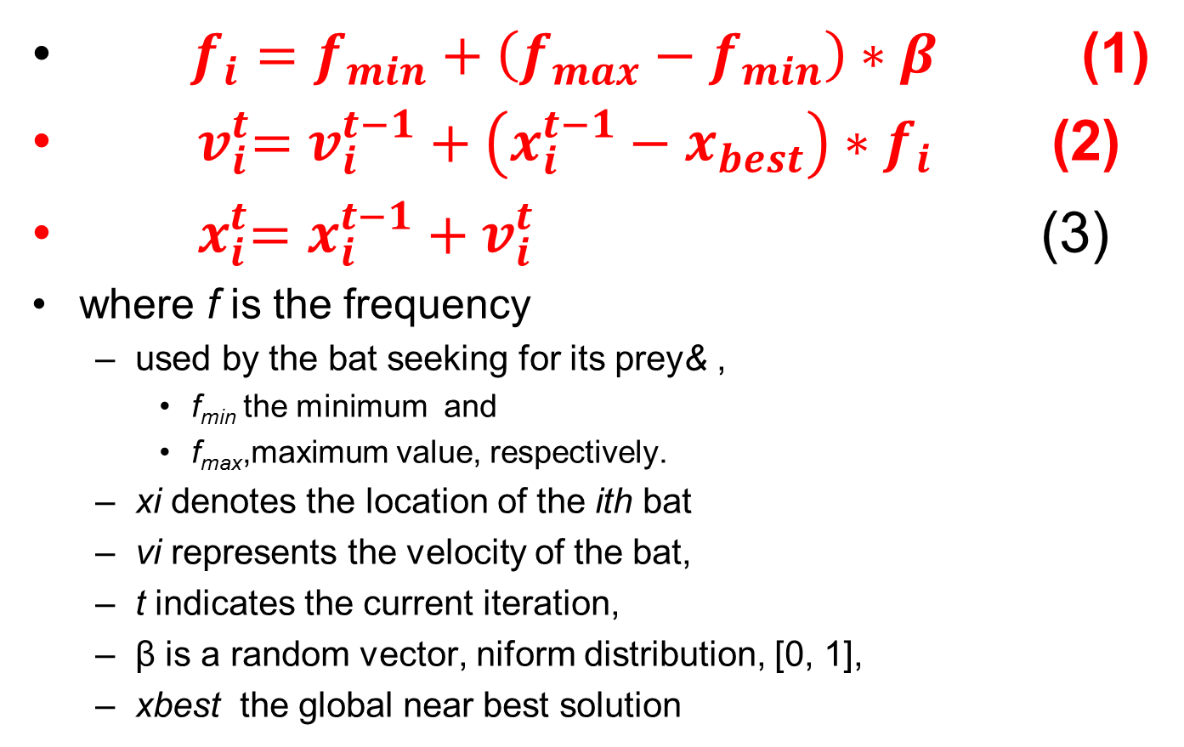
4.1. Formulators
$f_{i}=f_{min}+\left(f_{max}−f_{min}\right)∗β$ (1)
${ v}_{i}^{t}=v_{i}^{t−1}+\left(x_{i}^{t−1}−x_{best}\right)∗f_{i}$ (2)
${ x}_{i}^{t}=x_{i}^{t−1}+v_{i}^{t}$ (3)
where f is the frequency
used by the bat seeking for its prey& ,
f_{min} the minimum and
f_{max},maximum value, respectively.
xi denotes the location of the ith bat
vi represents the velocity of the bat,
t indicates the current iteration,
β is a random vector, niform distribution, [0, 1],
xbest the global near best solution

Slide 51
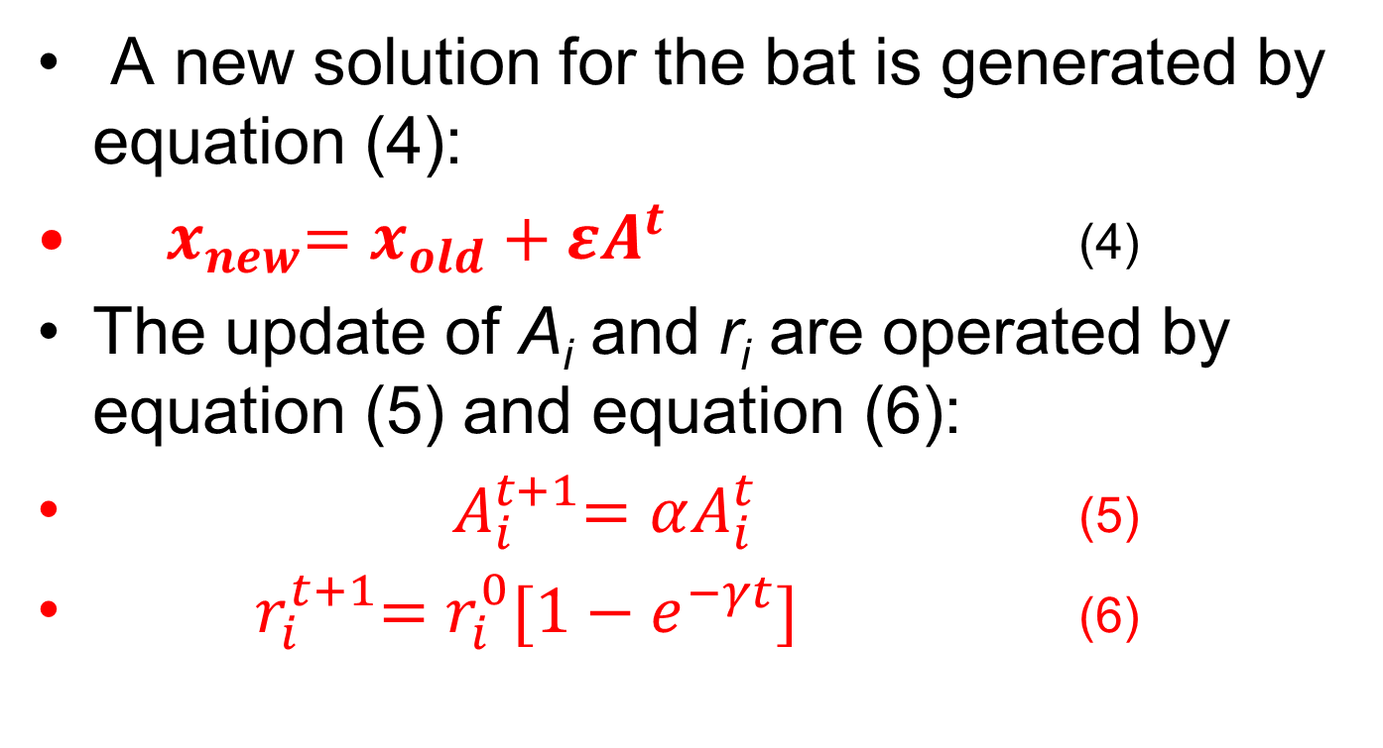
Formulators
A new solution for the bat is generated by equation (4):
${ x}_{new}=x_{old}+εA^{t}$ (4)
The update of A_{i} and r_{i} are operated by equation (5) and equation (6):
${ A}_{i}^{t+1}=αA_{i}^{t}$ (5)
${ r}_{i}^{t+1}=r_{i}^{0}[1−e^{−γt}]$ (6)

Slide 52
The process of Bat Algorithm
Step 1. Initialize the bat population, the pulse rates, the loudness, and define the pulse frequency
Step 2. Update the velocities to update the location of the bats, and decide whether detonate the random walk process.
Step 3. Rank the bats according to their fitness value, find the current near best solution found so far, and then update the loudness and the emission rate.
Step 4. Check the termination condition to decide whether go back to step 2 or end the process and output the result

Slide 53
5. Artificial Bee Colony Algorithm
ABC is developed based on inspecting
the behaviors of real bees on finding nectar and
sharing the information of food sources to the bees in the hive
Three types of bee in ABC
The Employed Bee
The Onlooker Bee
The Scout

Slide 54

BA
$x_{i}^{t}=x_{i}^{t−1}+\left(x_{i}^{t−1}−x_{best}\right)∗f_{i}$ (if rand <r)
${ x}_{new}=x_{old}+εA^{t}$ otherwise

Slide 55
5.2 Agents in ABC
The Employed Bee: It stays on a food source and provides the neighborhood of the source in its memory.
The Onlooker Bee: It gets the information of food sources from the employed bees in the hive and select one of the food source to gathers the nectar.
The Scout: It is responsible for finding new food, the new nectar, sources

Slide 56
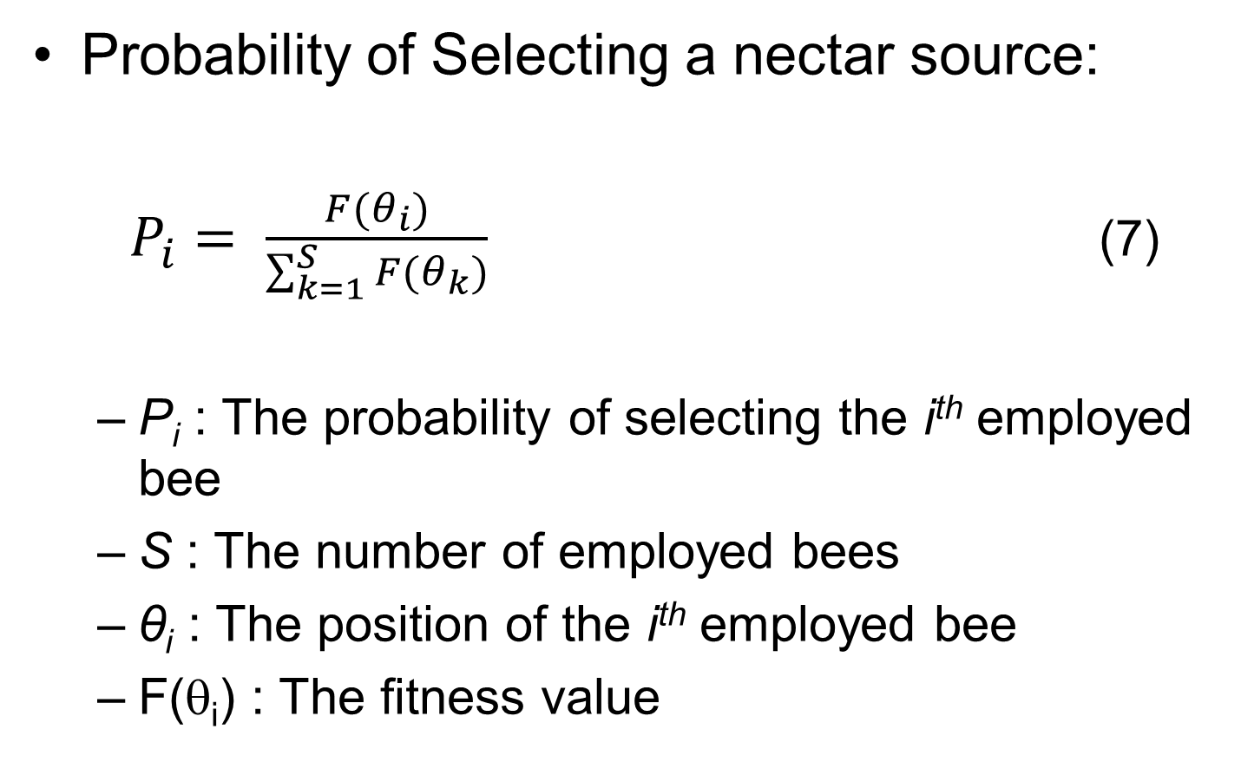
5.2 Movement of the Onlookers
Probability of Selecting a nectar source:
$P_{i}= \frac{F(θ_{i})}{\sum_{k=1}^{S}{F(θ_{k})}}$ (7)
P_{i} : The probability of selecting the i^{th} employed bee
S : The number of employed bees
θ_{i} : The position of the i^{th} employed bee
F(θ_{i}) : The fitness value

Slide 57
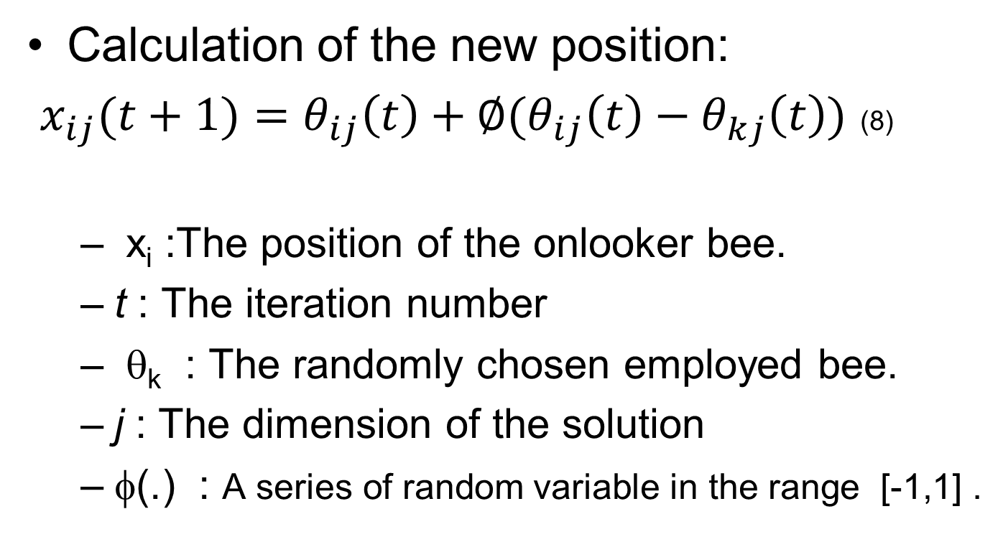
5.2 Movement of the Onlookers (2)
Calculation of the new position:
$x_{ij}(t+1)=θ_{ij}\left(t\right)+∅(θ_{ij}\left(t\right)−θ_{kj}\left(t\right))$ (8)
x_{i} :The position of the onlooker bee.
t : The iteration number
θ_{k} : The randomly chosen employed bee.
j : The dimension of the solution
φ(.) : A series of random variable in the range [-1,1] .

Slide 58
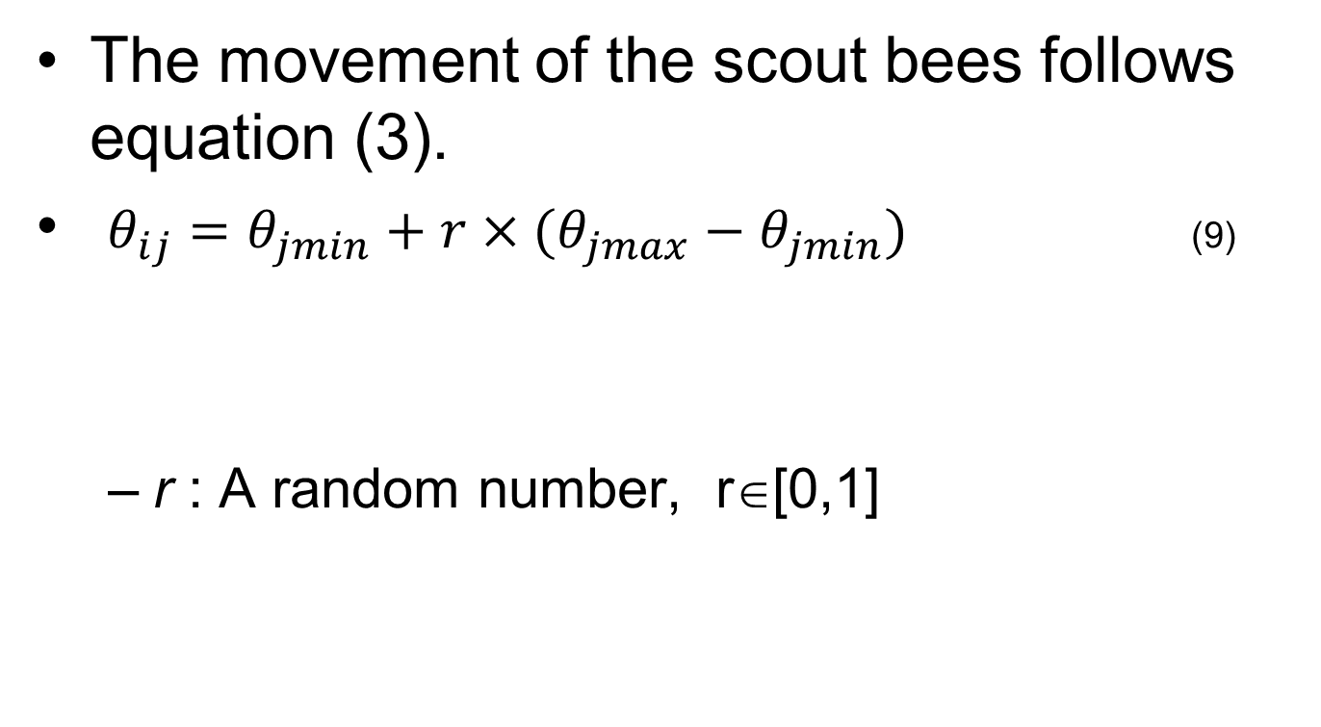
Movement of the Scouts
The movement of the scout bees follows equation (3).
$θ_{ij}=θ_{jmin}+r×(θ_{jmax}−θ_{jmin})$ (9)
r : A random number, r∈[0,1]

Slide 59
5.2 Artificial Bee Colony (ABC) (4)
Record the best solution found so far
The Employed Bee
The Onlooker Bee
The Scout

Slide 60
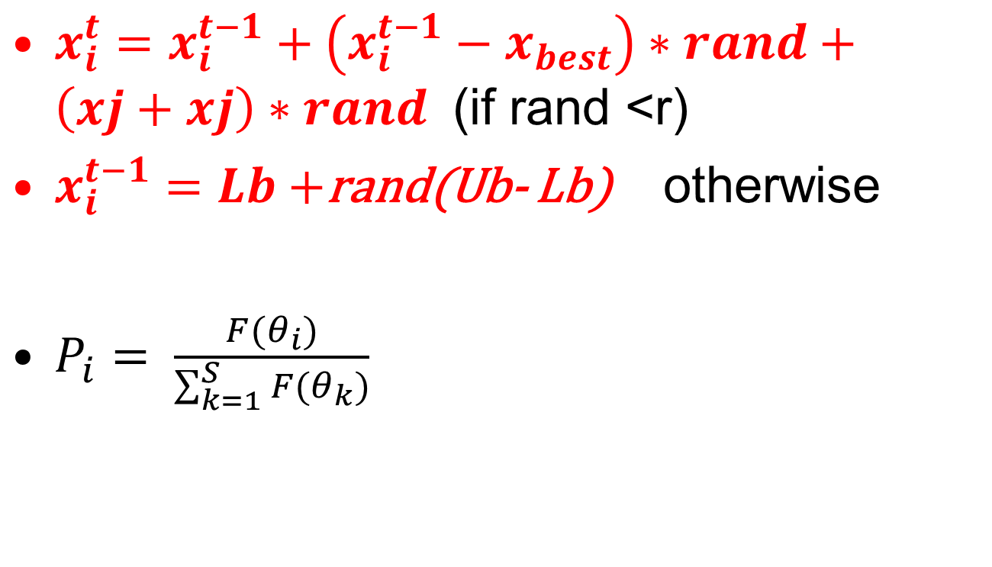
ABC rewrite
$x_{i}^{t}=x_{i}^{t−1}+\left(x_{i}^{t−1}−x_{best}\right)∗rand+\left(xj+xj\right)∗rand$ (if rand <r)
$x_{i}^{t−1}=Lb+$rand(Ub- Lb) otherwise
$P_{i}= \frac{F(θ_{i})}{\sum_{k=1}^{S}{F(θ_{k})}}$

Slide 61
6. Demo with BA

Slide 62
Demo ABC(cont.)

Slide 63
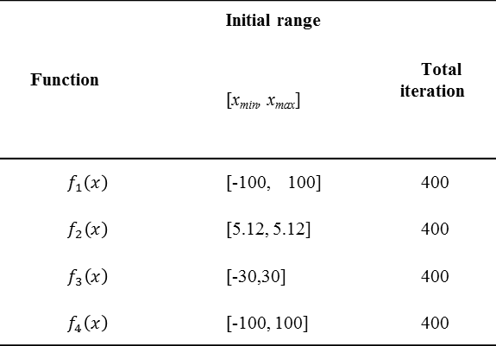
The benchmark functions Griewank, Rastrigin, Rosenbrock and Spherical
$f_{1}\left(x\right)=1+\sum_{i=1}^{N}{\frac{x_{i}^{2}}{4000}}+\prod_{i=1}^{N}{cos\frac{x_{i}}{\sqrt{i}}}$ (10)
$f_{2}\left(x\right)=\sum_{i=1}^{N}{{[10+x}_{i}^{2}−10cos2πx_{i}}$ (11)
${ f}_{3}\left(x\right)=\sum_{i=1}^{n−1}{(100{\left(x_{i−1}−x_{i}^{2}\right)}^{2}+{(1−x_{i})}^{2}}$ (12)
${ f}_{4}\left(x\right)=\sum_{i=1}^{N}{x_{i}^{2}}$ (13)
Function | Initial range | Total iteration
 | [x_{min}, x_{max}]
$$f_{1}\left(x\right)$$ | [-100, 100] | 400
$$f_{2}\left(x\right)$$ | [5.12, 5.12] | 400
$$f_{3}\left(x\right)$$ | [-30,30] | 400
$$f_{4}\left(x\right)$$ | [-100, 100] | 400
Table 1. The initial range and the total iteration of test standard functions.

Slide 64
Conclusions
Optimization
DE
FPA
BA
ABC

Slide 65
Conclusions (cont.)
Four benchmark functions are used to test
the behavior of convergence,
the accuracy, and
the speed of the proposed method.

Slide 66
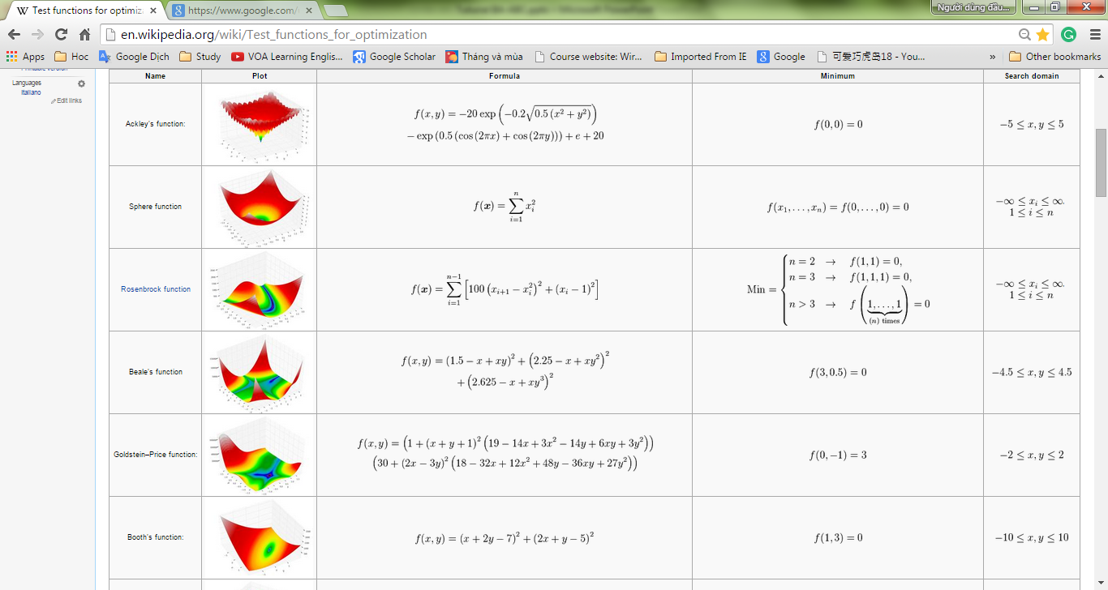
Test functions

Slide 67
Thank you!

